Slide 1
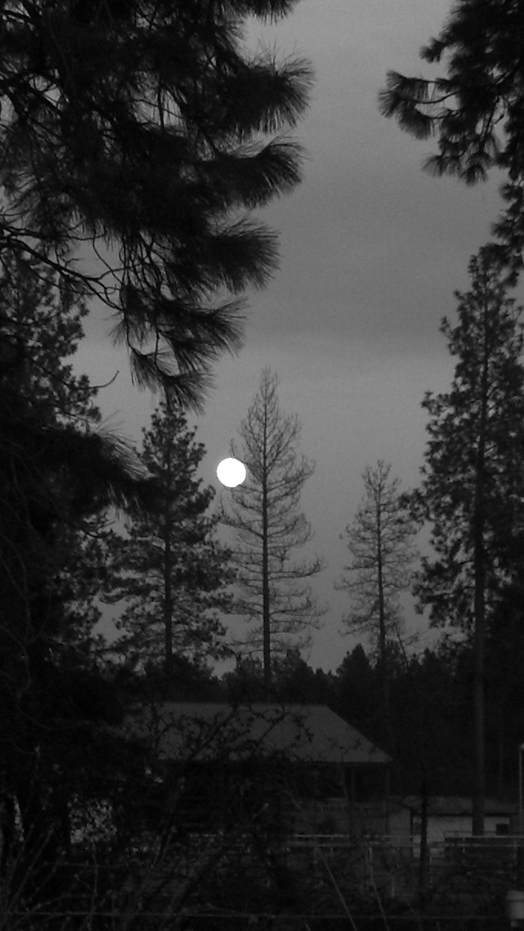
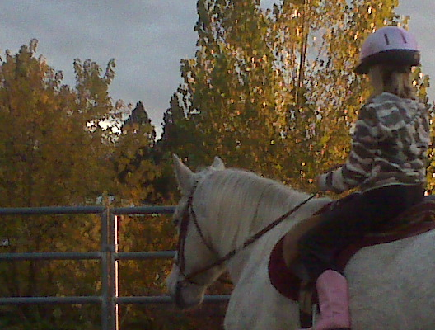
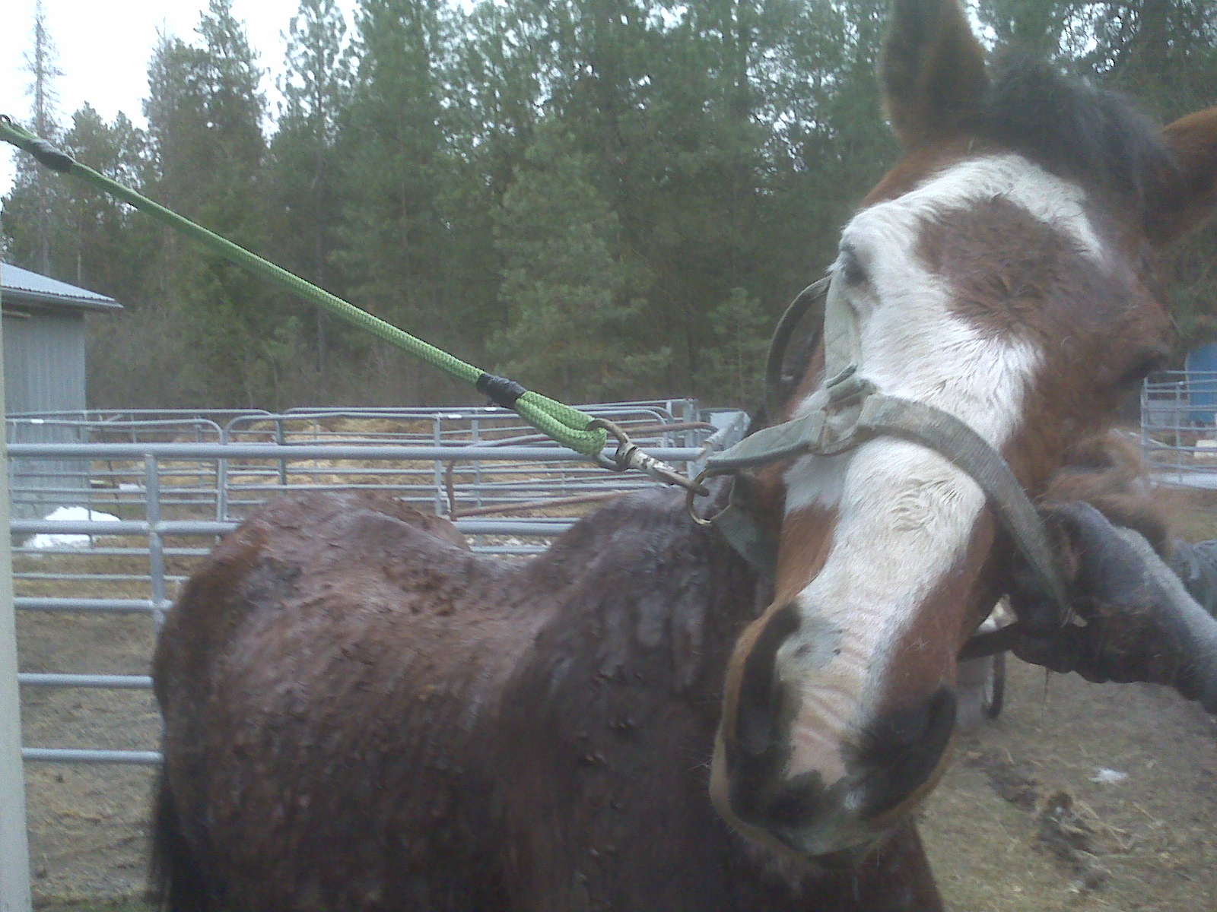
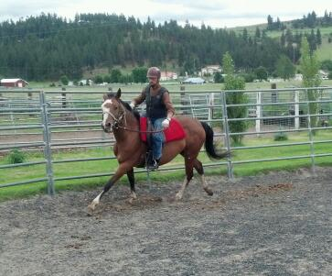
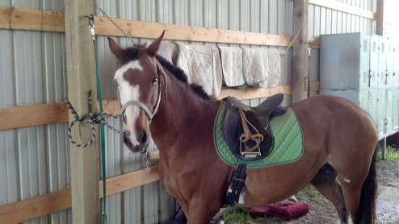
Full Circle
EquineRehabilitation Center
Enriching lives while saving others
Notes:
pagw page two how can i put it thete?

Slide 2
What is Full Circle?
Full Circle is a program designed to provide quality care and rehabilitation for horses in need while preparing them for placement in suitable homes.
Through our scholarship and volunteer programs Full Circle will allow anyone with the interest in learning and the desire to help an opportunity to participate in the care and handling of these amazing and deserving animals.

Slide 3
Why Full Circle?
There is a need for this program. There are many of us affected by the downturn in our economy and our horses are among the animals whose families may no longer have the means to provide for their care.
People, especially children, need to experience the joy of connecting with nature. They need to feel the satisfaction that comes from hard work and a job well done. They need the opportunity to help others and receive their gratitude.

Slide 4
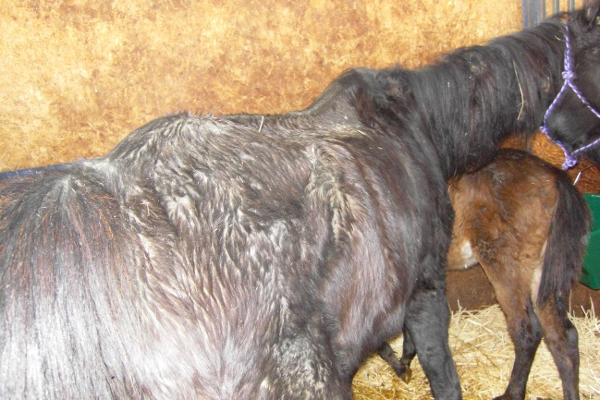
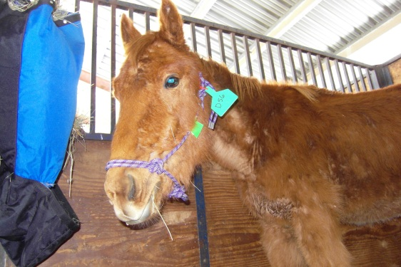
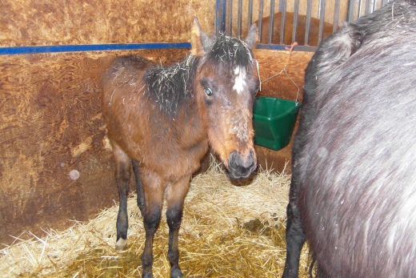
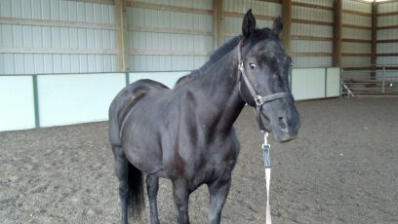
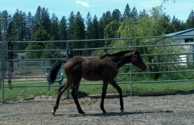
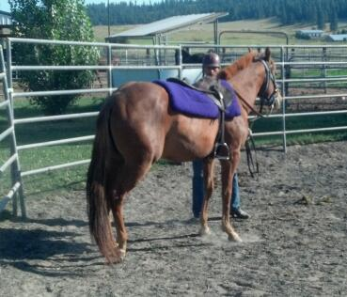
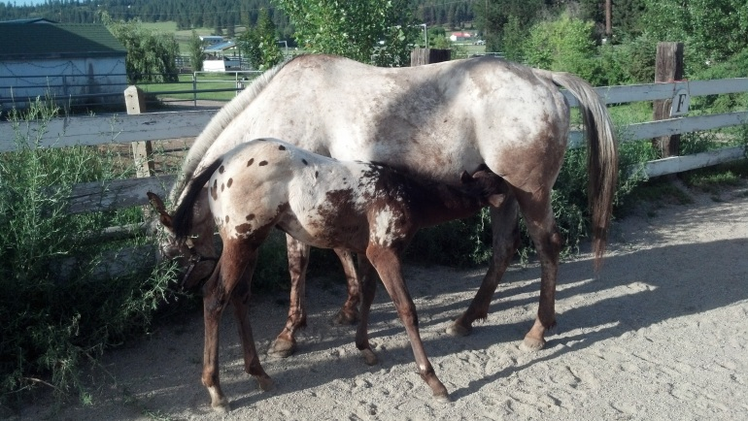
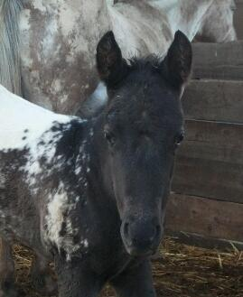
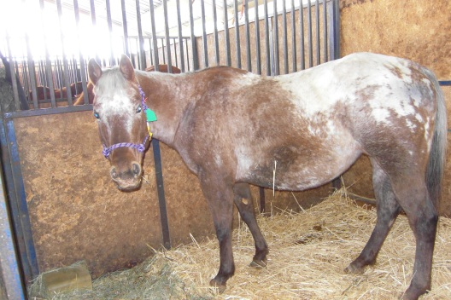
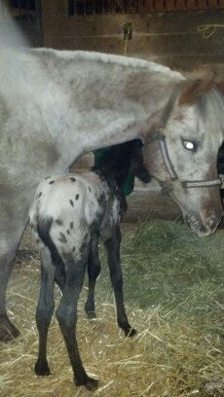
What Full Circle Can Do…..

Slide 5
Who will benefit from Full Circle?
Full Circle is designed to provide an opportunity for anyone with the desire to learn and work hard to build the skills needed to handle and care for horses.
Learning the skills needed to rehabilitate, retrain and rehome the horses in the program at Full Circle will build confidence and compassion in all those fortunate enough to participate in the process .

Slide 6
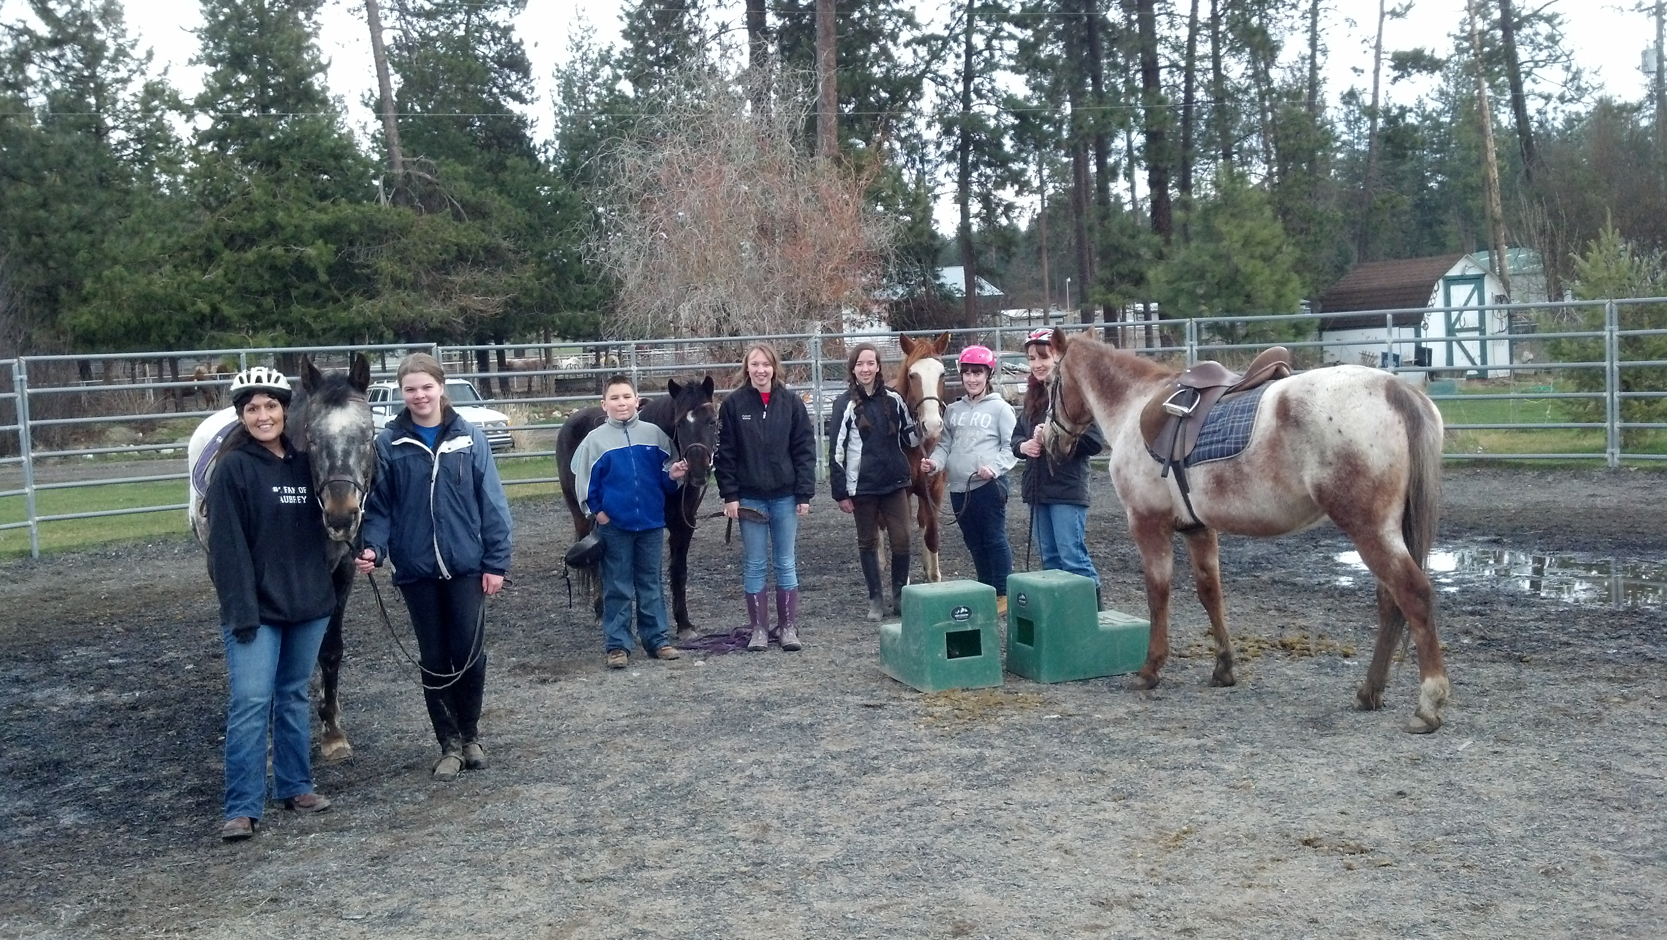
We have known for many years how beneficial the outside of a horse can be for the inside of a man. Full Circle is a place where anyone who wishes can experience the magic that occurs when horses and people come together. While the horses are in need of quality care and affection what they give back to their caregivers is often times well beyond words.....

Slide 7
How did Full Circle come to be?
Full Circle is the culmination of a livelong passion for horses and a desire to share that passion with other's who will benefit from providing these amazing animals the love and care they deserve.
Full Circle is here because there are horses in need of help and there are people who want to help them.
Full Circle is here because there are people who need to learn the lessons helping these horses will teach.

Slide 8
How Can You Help?
Become a Member
Sponsor a Horse
Sponsor a Student
Donate Supplies/Feed/Services
Volunteer Your Time
Help With a Fundraiser

